Slide 1
Review of Probability Theory

Slide 2
Introduction to Probability
Experiments
Counting Rules
Events and Their Probability
Some Basic Relationships of Probability
Conditional Probability
Bayes’ Theorem

Slide 3
Why to study Probability?
Do you know what happen tomorrow?
Nothing in life is certain. In everything we do, we gauge the chances of successful outcomes.
Uncertainties in the World
Weather and natural events
Getting hit by a disease or an epidemic
Political party winning an election
Transport
In all these cases, we understand that some repetitive process generates outcomes that are not deterministic but nevertheless exhibit a rational pattern.

Slide 4
Why to study Probability?
Uncertainties in the World
Weather and natural events
Getting hit by a disease or an epidemic
Political party winning an election
Transport
In all these cases, we understand that some repetitive process generates outcomes that are not deterministic but nevertheless exhibit a rational pattern.
For example, each rotation of the planet brings a new day, on which rain may or may not occur.
We interpret a 40% chance of rain as meaning that over an extended run of days, 40% of them will be rainy.

Slide 5
Probability as a Numerical Measure of the Likelihood of Occurrence
Probability theory provides a rigorous mathematical framework for investigating phenomena that exhibit repeatable patterns, even though individual outcomes may appear random.
The probability of an event is a numerical value that measures the likelihood that the event can occur
Probability values are always assigned on a scale from 0 to 1.
A probability near zero indicates an event is quite unlikely to occur
A probability near one indicates an event is almost certain to occur.

Slide 6
Probability Experiments
A probability experiment is an action through which specific results (counts, measurements or responses) are obtained.
Example: Toss a die and observing the number that is rolled is a probability experiment.
The result of a single trial in a probability experiment is the outcome.
The set of all possible outcomes for an experiment is the sample space.
Example: The sample space when tossing a die has six outcomes. {1, 2, 3, 4, 5, 6}

Slide 7
Event
An event consists of one or more outcomes and is a subset of the sample space.
Example: A die is tossed. Event A is observing an even number.
A = {2, 4, 6}.
A simple event is an event that consists of a single outcome.

Slide 8

Event
The die toss:
Simple events: Sample space:
1
E₁
E₂
E₃
E₄
E₅
E₆
S ={E₁, E₂, E₃, E₄, E₅, E₆}
2
S
E₁
E₃
3
E₅
4
E₂
E₆
5
E₄
6

Slide 9
Event
Two events are mutually exclusive if, when one event occurs, the other cannot, and vice versa.
Example: Toss a die.
A: Observe an odd number
B: Observe a number greater than 2
C: Observe a 6
D: observe a 3
A and B?
C and D?
B and C?
B and D?
Not Mutually Exclusive
Mutually Exclusive
Not Mutually Exclusive
Not Mutually Exclusive

Slide 10

The Probability of an Event
The probability of an event A measures “how often” A will occur. We write P(A).
Suppose that an experiment is performed n times. The relative frequency for an event A is
Example: A die is Tossed. Find the probability of Event A: rolling a 5.
There is one outcome in Event A: {5}
P(A) =
“Probability of Event A.”

Slide 11
The Probability of an Event
P(A) must be between 0 and 1.
The sum of the probabilities for all simple events in S equals 1.
Probabilities can be found using
Estimates from empirical studies
Common sense estimates based on equally likely events
Examples:
Toss a fair coin.
Suppose that 10% of the U.S. population has red hair. Then for a person selected at random
P(Head) = 1/2
P(Red hair) = .10

Slide 12
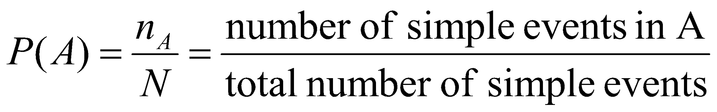
Using Simple Events
The probability of an event A is equal to the sum of the probabilities of the simple events contained in A
If the simple events in an experiment are equally likely, then

Slide 13
Using Simple Events: Example 1
Toss a fair coin twice. What is the probability of observing at least one head?
1st Coin 2nd Coin E_{i} P(E_{i})
H
HH
1/4
H
T
HT
1/4
P(at least 1 head)
= P(E₁) + P(E₂) + P(E₃)
= 1/4 + 1/4 + 1/4 = 3/4
H
TH
1/4
T
T
TT
1/4

Slide 14
Using Simple Events: Example 2
A bowl contains three balls, one red, one blue and one green. A child selects two ball at random. What is the probability that at least one is red?
1st ball 2nd ball E_{i} P(E_{i})
m
RB
1/6
m
P(at least 1 red)
= P(RB) + P(BR)+ P(RG) + P(GR)
= 4/6 = 2/3
m
RG
1/6
m
BR
m
1/6
m
BG
1/6
m
GB
1/6
m
m
GR
1/6

Slide 15
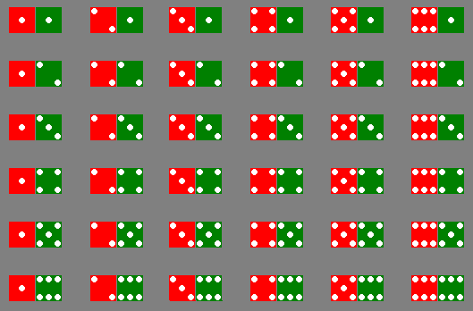
Using Simple Events: Example 3
The sample space of throwing a pair of dice is

Slide 16
Using Simple Events: Example 3
Event | Simple events | Probability
Dice add to 3
Dice add to 6
(1,2),(2,1)
2/36
(1,5),(2,4),(3,3),
(4,2),(5,1)
5/36

Slide 17
Counting Rules
Sample space of throwing 3 dice has 216 entries, sample space of throwing 4 dice has 1296 entries, …
At some point, we have to stop listing and start thinking …
We need some counting rules

Slide 18
The mn Rule
If an experiment is performed in two stages, with m ways to accomplish the first stage and n ways to accomplish the second stage, then there are mn ways to accomplish the experiment.
This rule is easily extended to k stages, with the number of ways equal to
n₁ n₂ n₃ … n_{k}
Example: Toss two coins. The total number of simple events is:
2 × 2 = 4

Slide 19
The mn Rule
Example: Toss three coins. The total number of simple events is:
2 × 2 × 2 = 8
Example: Toss two dice. The total number of simple events is:
6 × 6 = 36
Example: Toss three dice. The total number of simple events is:
6 × 6 × 6 = 216

Slide 20
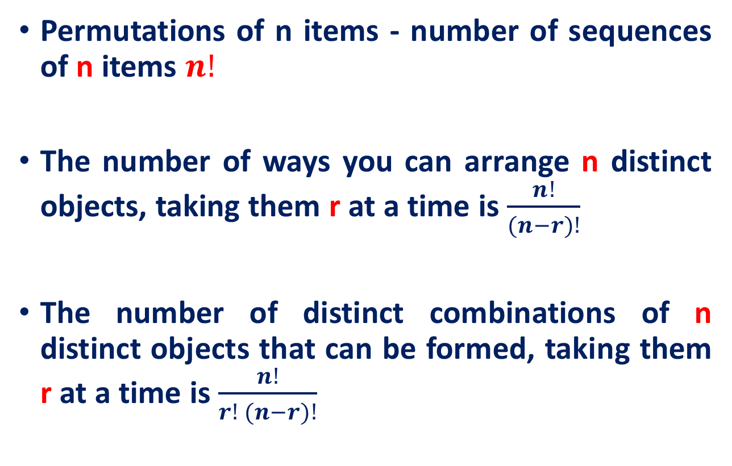
Combinatorial reasoning

Slide 21


Example
How many 3-digit lock combinations (without repetition) can we make from the numbers 1, 2, 3, and 4?
The order of the choice is important!
Three members of a 5-person committee must be chosen to form a subcommittee. How many different subcommittees could be formed?
The order of the choice is not important!

Slide 22
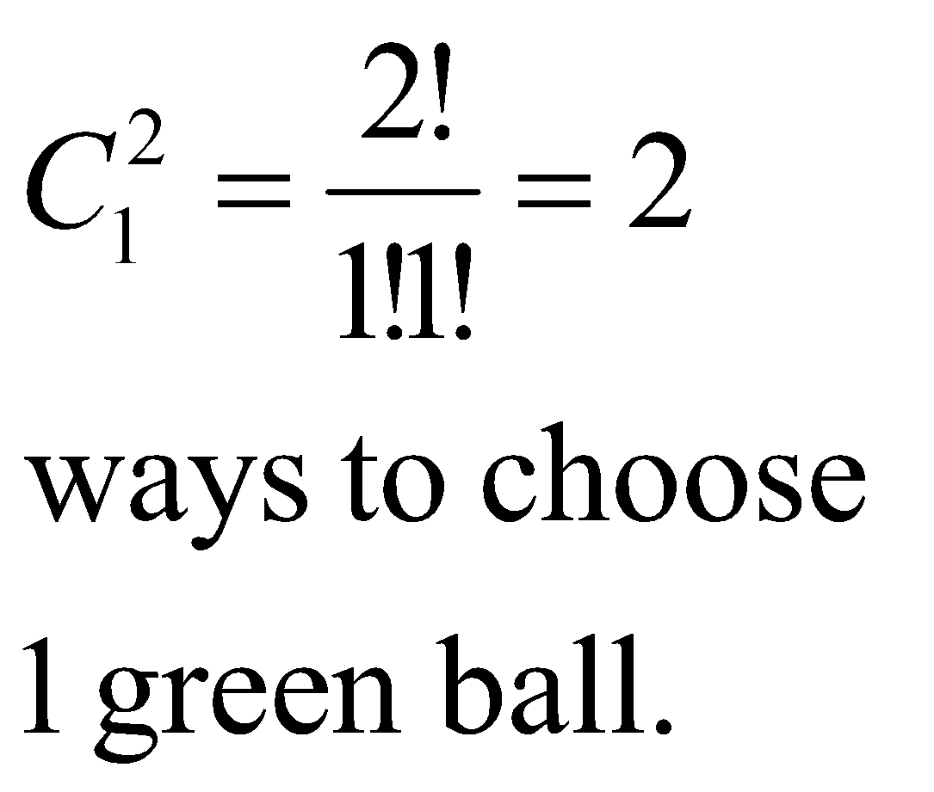
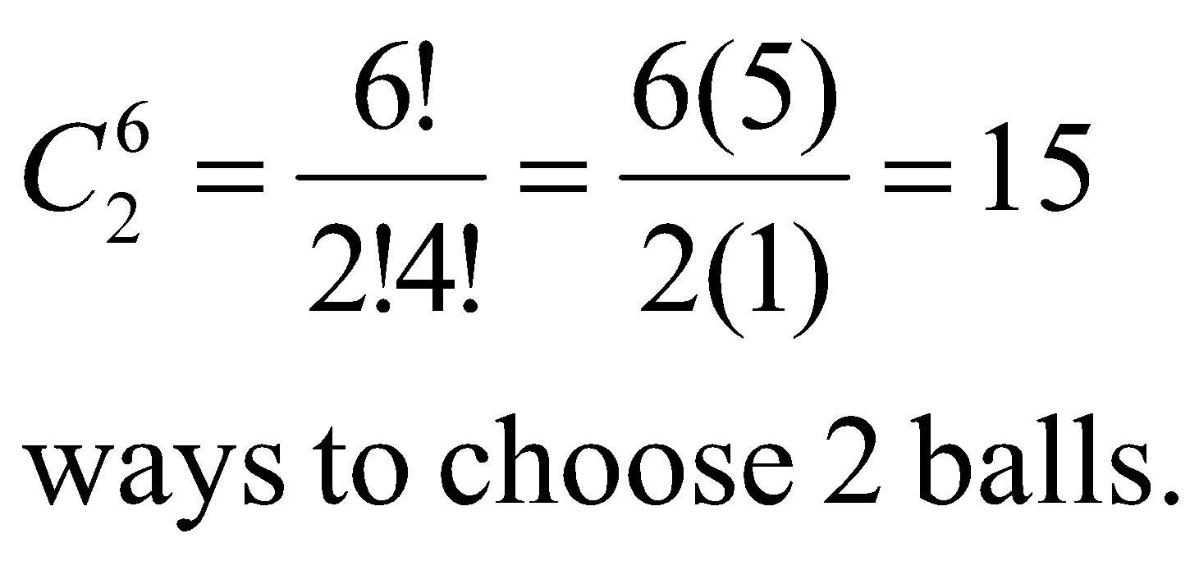
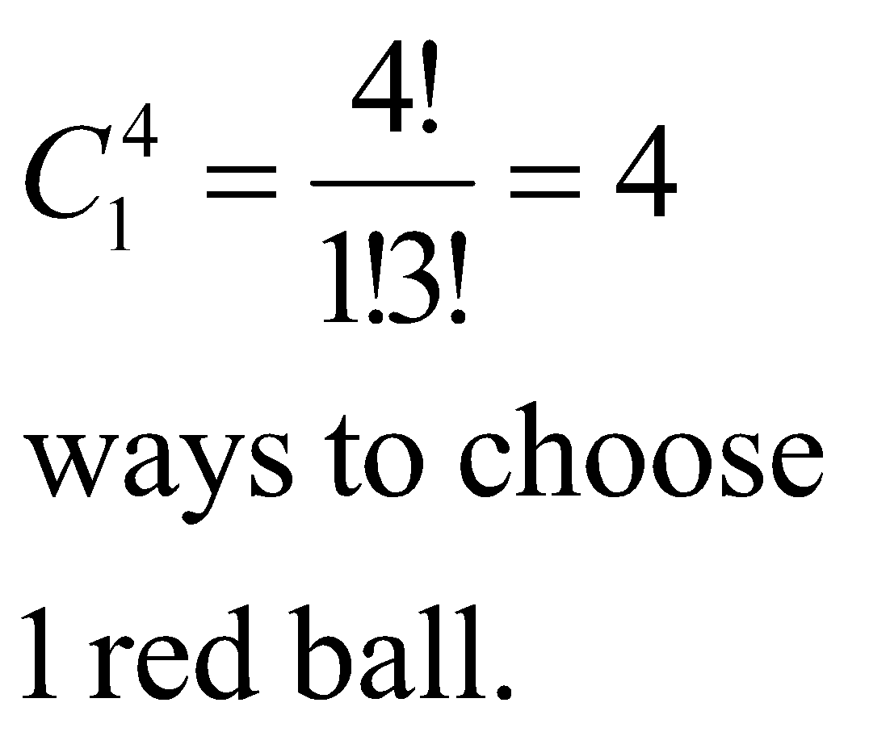
Example
A box contains six balls four red and two green. A child selects two balls at random. What is the probability that exactly one is red?
The order of
the choice is
not important!
4 × 2 =8 ways to choose 1 red and 1 green balls.
P(exactly one red) = 8/15

Slide 23
Some Basic Relationships of Probability
There are some basic probability relationships that can be used to compute the probability of an event without knowledge of all the sample point probabilities.
Complement of an Event
Union of Two Events
Intersection of Two Events
Mutually Exclusive Events

Slide 24
Complement of an Event
The complement of event A is defined to be the event consisting of all sample points that are not in A.
The complement of A is denoted by A^{c}.
Sample
Space S
Example: Select a student from the classroom and record his/her hair color and gender.
A: student has brown hair
B: student is female
C: student is male
Event A
A^{c}
Venn
Diagram
C^{C?}
B

Slide 25
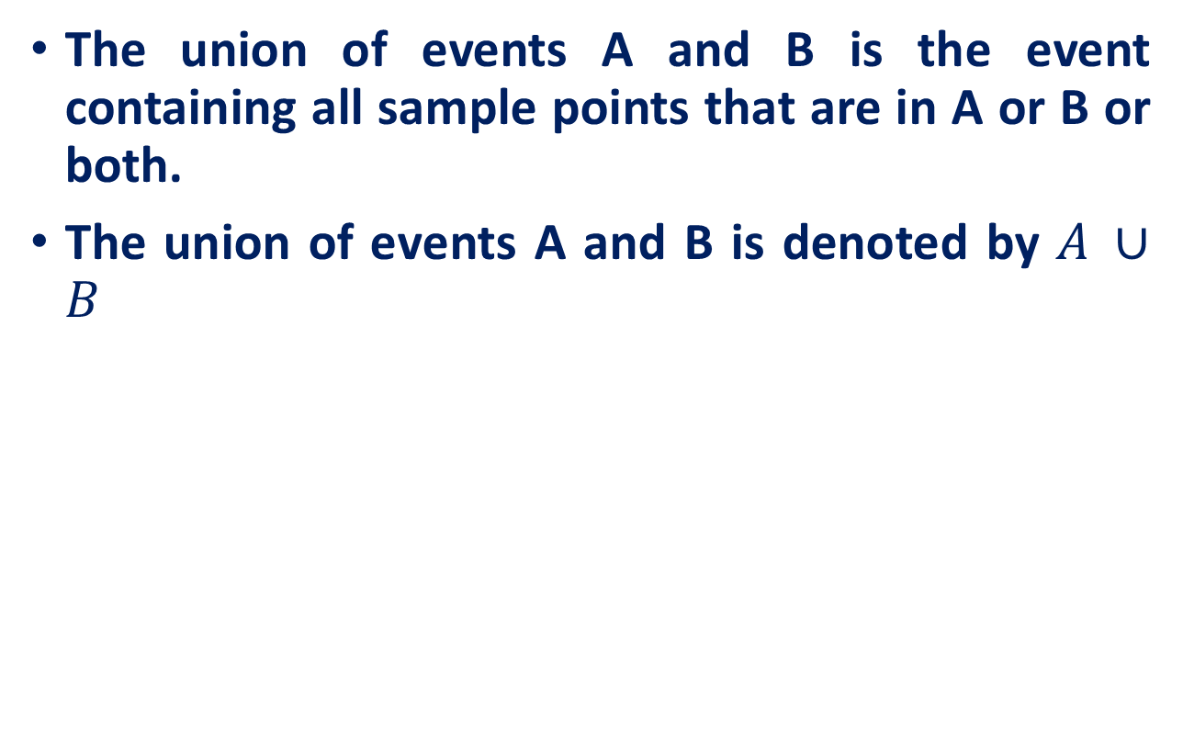

Union of Two Events
Sample
Space S
Example: Select a student from the classroom and record his/her hair color and gender.
A: student has brown hair
B: student is female
C: student is male
Event A
Event B
All students

Slide 26
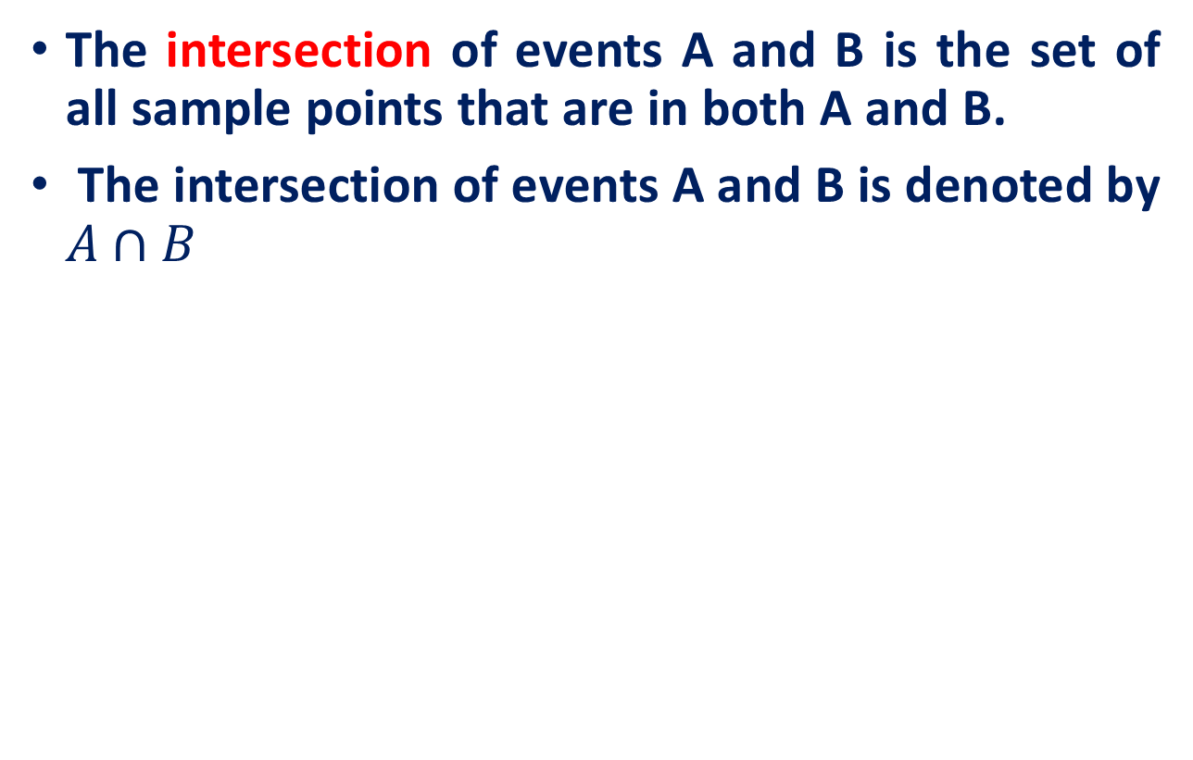
Intersection of Two Events
Sample
Space S
Event A
Event B
Intersection of A and B

Slide 27
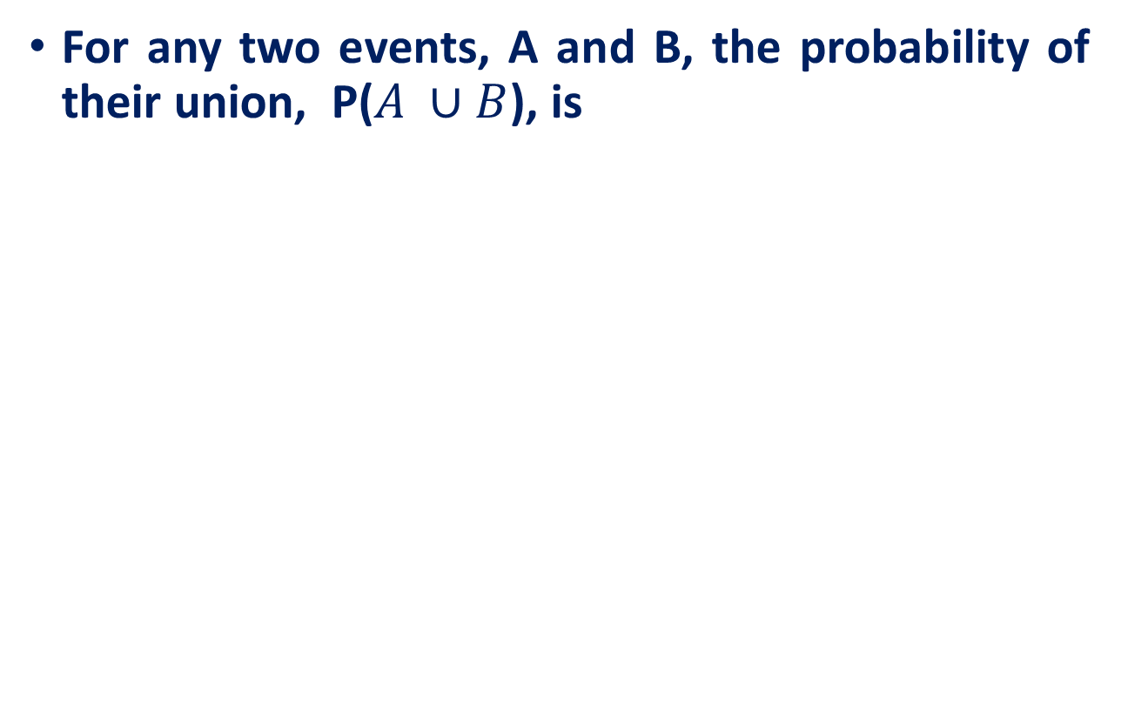
The Additive Rule for Unions
A
B

Slide 28

Example: Additive Rule
Example: Suppose that there were 120 students in the classroom, and that they could be classified as follows:
A: brown hair
P(A) = 50/120
B: female
P(B) = 60/120
 | Brown | Not Brown
Male | 20 | 40
Female | 30 | 30
P(A∪B) = P(A) + P(B) – P(A∩B)
= 50/120 + 60/120 - 30/120
= 80/120 = 2/3

Slide 29

Example: Two Dice
A: red die show 1
B: green die show 1
P(A∪B) = P(A) + P(B) – P(A∩B)
= 6/36 + 6/36 – 1/36
= 11/36

Slide 30
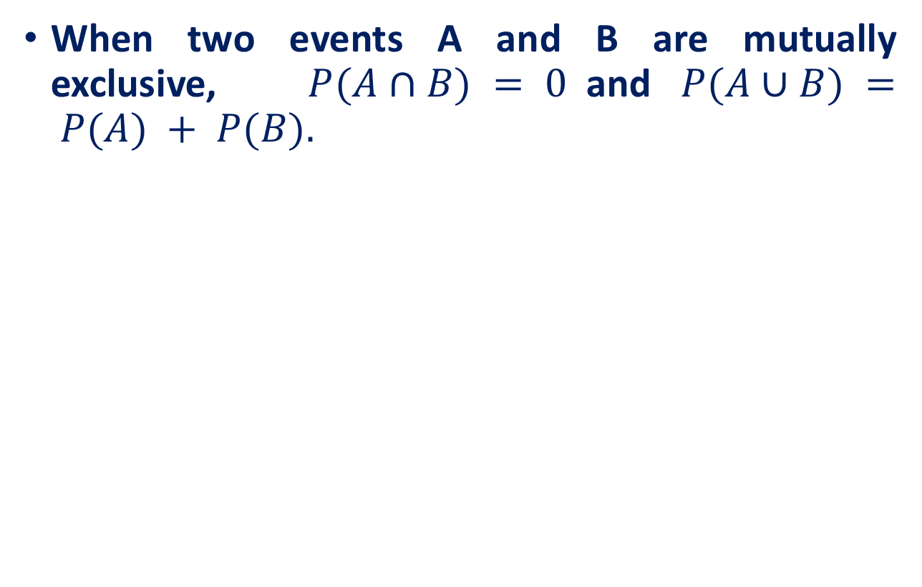
A Special Case
A: male with brown hair
P(A) = 20/120
B: female with brown hair
P(B) = 30/120
 | Brown | Not Brown
Male | 20 | 40
Female | 30 | 30
P(A∪B) = P(A) + P(B)
= 20/120 + 30/120
= 50/120
A and B are mutually exclusive, so that

Slide 31
Calculating Probabilities for Complements
P(A ∩ A^{C}) = 0
P(A ∪ A^{C}) =1
Since either A or A^{C} must occur,
P(A)+ P(A^{C}) = 1
P(A^{C}) = 1- P(A)
A^{C}
A

Slide 32
Example
Select a student at random from the classroom. Define:
A: male
P(A) = 60/120
B: female
P(B) = ?
 | Brown | Not Brown
Male | 20 | 40
Female | 30 | 30
A and B are complementary, so that
P(B) = 1- P(A)
= 1- 60/120 = 60/120

Slide 33
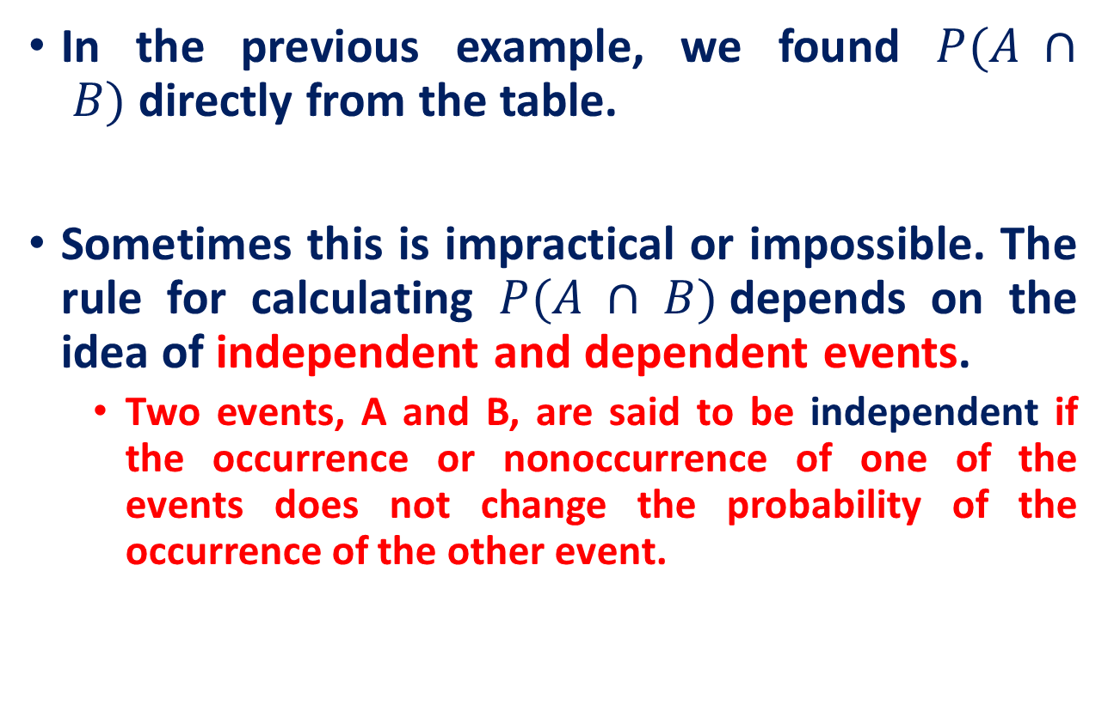
Calculating Probabilities for Intersections

Slide 34
Practice Exercises
Two cards are randomly drawn from a deck of 52 playing cards. find the probability that both cards will be greater than 3 and less than 8.
4 candidates are seeking a vacancy on a school board. If A is twice as likely to be elected as B, and B and C are given about the same chance of being elected, while C is twice as likely to be elected as D, then what are the probabilities that C will win? A will not win?

Slide 35
Topic for the next class
Conditional Probabilities

Slide 36
Reference
Statistics with Economics and Business Applications, Chapter 3 Probability and Discrete Probability Distributions
Modern Business Statistics, Slides by John Loucks

